Slide 1
Symbols
Animal Farm presentation

Slide 2
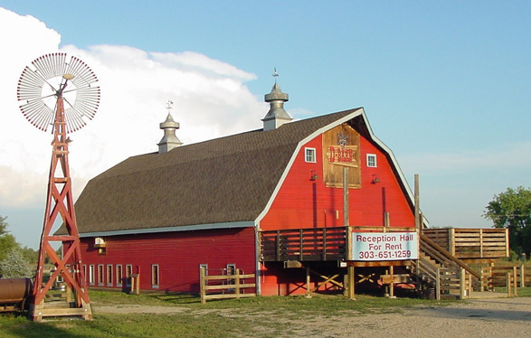
The barn
p

